Slide 1

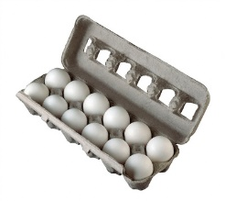
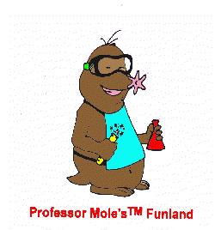
WHAT IS A MOLE?
The mole is a convenient unit to measure the very large number of particles present in a substance.
We count shoes in pairs: 2
We count eggs by the dozen: 12
In chemistry we count particles in moles: 6.02 x 10²³

Slide 2
CALCULATING FROM PARTICLES - Groups of 3 at boards
Amount in Particles
Amount in chosen unit (eg dozens or moles)

Slide 3
If you have 48 eggs how many dozens do you have?
Set up an EQUATION to get from particles to amount in DOZENS and solve it using:
p = Number of eggs you have (particles of egg)
N_{D} = number in 1 dozen
n = the number of dozens you have

Slide 4
Using your equation, solve for the number of dozens in 103 pens.
Set up an EQUATION and solve it using:
p = Number of eggs you have (particles of egg)
N_{D} = number in 1 dozen
n = the number of dozens you have
Now solve for how many pens are in 6.2 dozen.
DO NOT ERASE YOUR BOARD YET

Slide 5
WHAT DO WE MEAN BY PARTICLES?
Substance | Particles are called
Monoatomic elements i.e. copper (Cu) | atoms
Diatomic elements (i.e. O₂) or molecular compounds (i.e. H₂O) | molecules
Ionic compounds (i.e. NaCl) | formula units

Slide 6
WHY CREATE A NEW UNIT?
Matter consists of an incredibly large number of atoms.
How many atoms does a 1 cm x 1 cm x 1 mm piece of copper (Cu) contain?
Approximately 5,100,000,000,000,000,000,000 atoms!!!!!!
or
5.1 x10²¹ atoms!
This is very inconvenient!

Slide 7
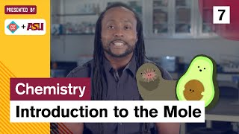

Slide 8
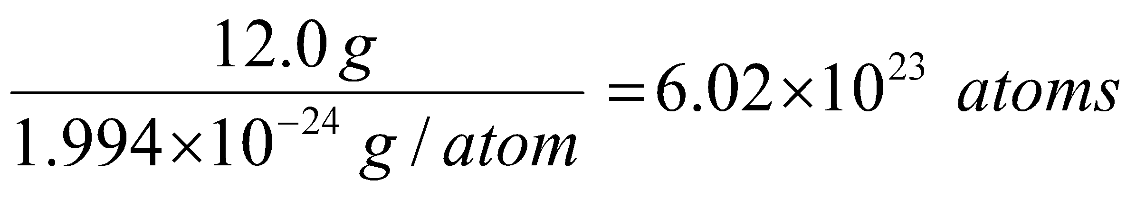
DEFINING THE MOLE
The mole was based on the number of atoms in 12 grams of the isotope carbon-12:
1 mole =
This is known as Avogadro’s Constant, or Avogadro’s Number (N_{A}).

Slide 9
CALCULATING MOLES FROM PARTICLES - Return to Groups of 3 at boards
Amount in Particles
Amount in MOLES

Slide 10
If you have 6.02x10²³ eggs how many moles do you have?
Set up an EQUATION to get from particles to amount in MOLES and solve it using:
p = Number of particles you have
N_{A} = number in 1 mole (this is Avogadro’s number)
n = the number of moles you have

Slide 11
If you have 1.81x10²⁴ eggs how many moles do you have?
Would your answer change if it was 1.81x10²⁴ particles of sodium (Na)?
How about if it was 1.81x10²⁴ particles of CO₂?

Slide 12
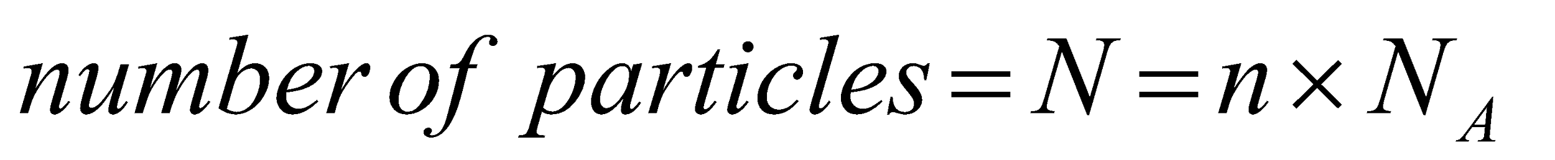
CALCULATING PARTICLES FROM MOLES
How many MgCl₂ formula units {ie particles} are present in 2.63 moles?
REARRANGE YOUR EQUATION

Slide 13
If you have 2 moles of Li, how many atoms (particles) do you have?
Again, would your answer change if it was 2 moles of Li₂O? 2 moles of C₂H₄? Of Elephants?

Slide 14
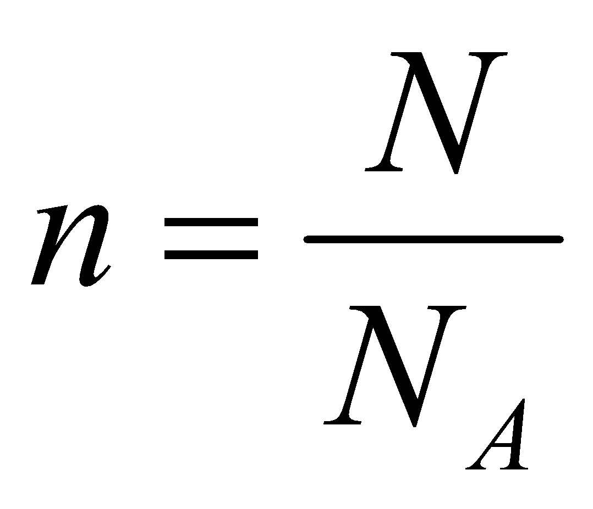
CALCULATING THE MOLES FROM PARTICLES
The number of moles of a substance can be determined using this formula:
Where: n = number of moles.
N = number of particles. (a “p” may be used instead of N)
N_{A} = Avogadro’s Constant
= 6.02 x 10²³

Slide 15
CALCULATING FROM MASS - Groups of 3 at boards
Make sure you have the equation for particles to moles on the top arrow
Amount in Particles
Amount in chosen unit (eg dozens or moles)
Amount in MASS

Slide 16
If you have 60 g of eggs how many dozens do you have? (1 dozen eggs = 30g)
Set up an EQUATION to get from amount in mass to amount in DOZENS and solve it using:
m = mass of eggs you have
MM = mass of 1 dozen eggs
n = the number of dozens you have

Slide 17
Using your equation:
If you have 3.2 dozen eggs how many grams do you have? (1 dozen eggs = 30g)
Using your equation:
If you have 3.2 dozen eggs how many EGGS (particles) do you have? Solve on that arrow!

Slide 18
For your 3.2 dozen eggs converted to mass of eggs or number of eggs, what is true about the actual quantity of eggs?

Slide 19
CALCULATING THE MOLES FROM MASS
The number of moles of a substance can be determined using this formula:
Where: n = number of moles.
m = mass of sample
MM = molar mass of the substance
m
n = MM
We will look at determining molar mass in the next slides!

Slide 20
BAD MOLE JOKES
Q: How did Avogadro write to his friends?
A: By e-mole!
Q: Why was Avogadro so rich?
A: He's a multi-mole-ionare!
Q: What does Avogadro put in his hot chocolate?
A: Marsh-mole-ows!
Q: Why did Avogadro like Cindy Crawford?
A: She's his favorite super-mole-dle (and she has a mole).
Q: What did the generous Avogadro say when his friends crashed his party?
A: The mole the merrier!

